Slide 1
Internet of Things (IoT) Course Introduction CS-339

Slide 2
Lectures
Location: F-10/F-4
Lecture materials
Lecture slides
YouTube videos
Materials from the Internet
Magazine articles & research papers
Student presentations
Invited lectures

Slide 3
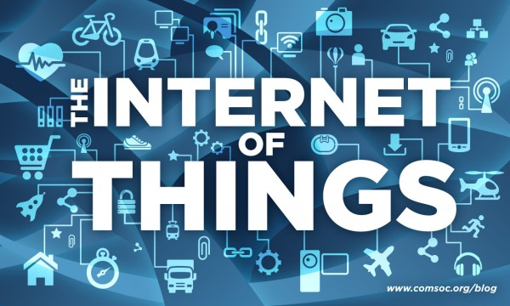
IoT
Source: IEEE ComSoc

Slide 4
Module Aims
The main aim of this module is to introduce the fundamental concepts of the Internet of Things and its applications and architecture models;
Introduction to the technologies and mechanisms for sensing, actuation, processing and cyber-physical data communication.
Discussing semantic technologies, service oriented solutions and networking technologies that enable the integration of Internet of Things data and services into the cyber world (i.e. the Internet and the Web).
To develop practical skills that can be transferred into a real-world environment.

Slide 5
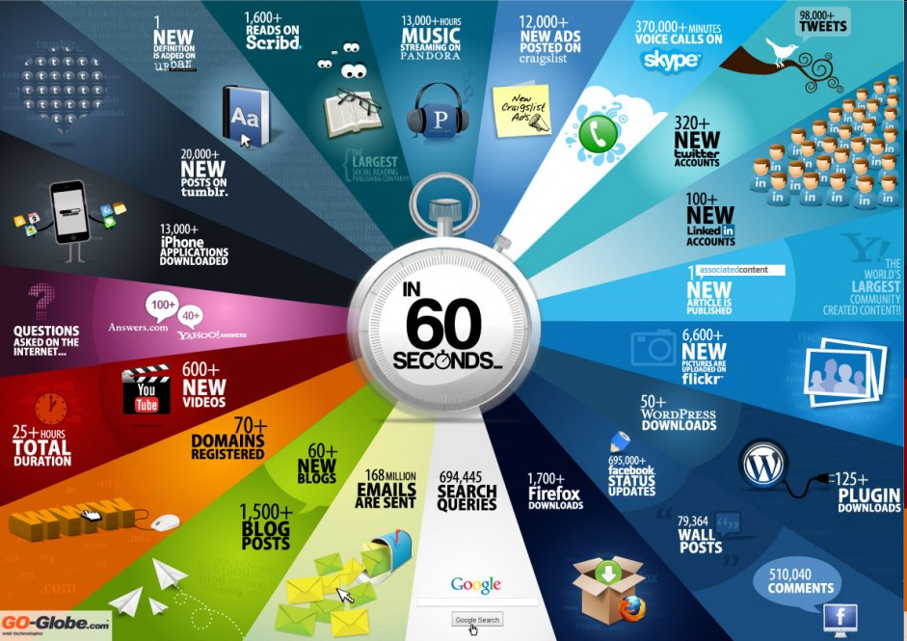

Slide 6
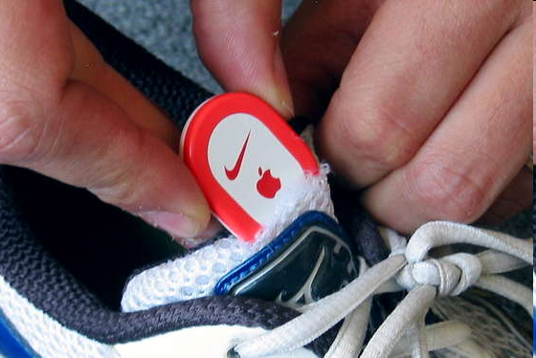
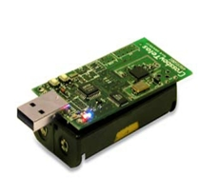
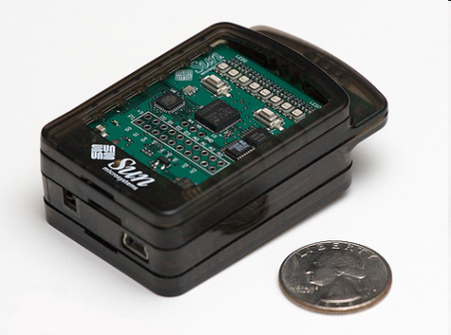
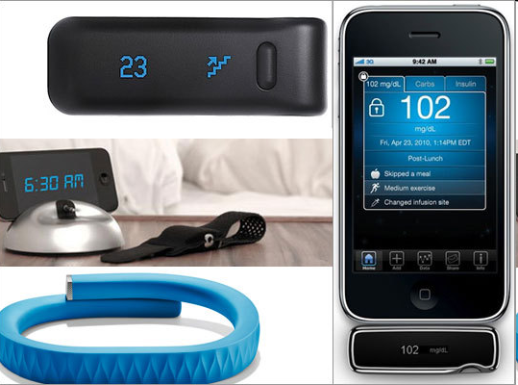
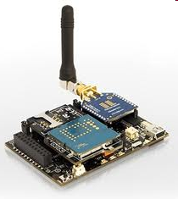
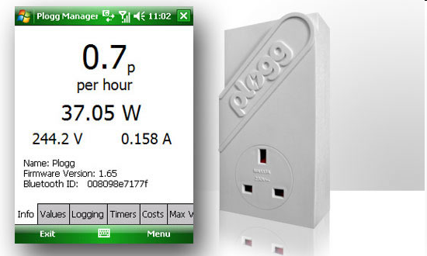
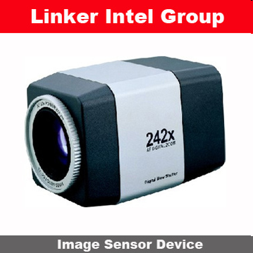
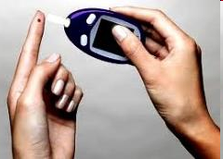
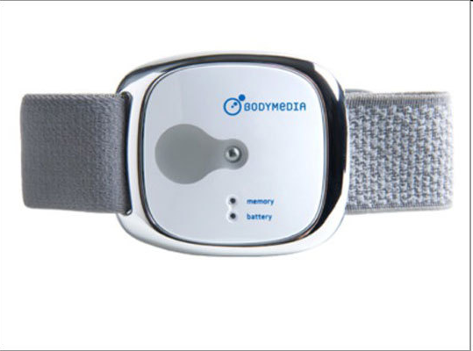
Sensors
- Programmable devices
- Off-the-shelf gadgets/tools

Slide 7
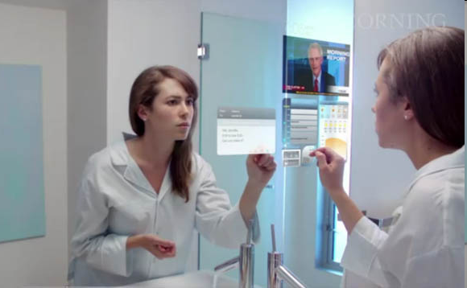
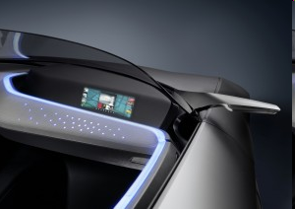
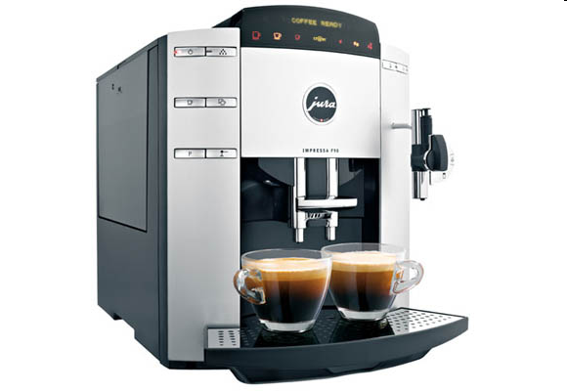
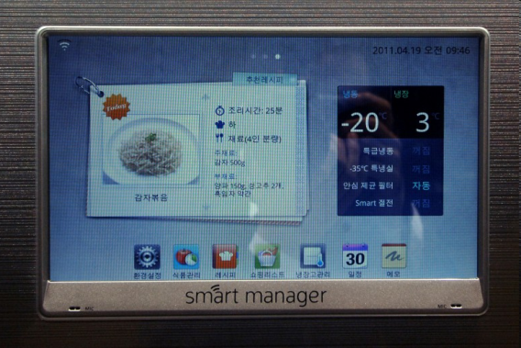
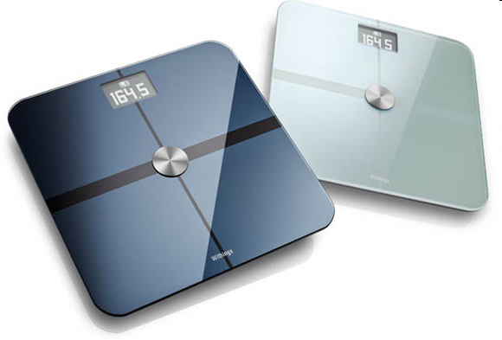
More “Things” are being connected
Home/daily-life devices
Business and
Public infrastructure
Health-care
…

Slide 8





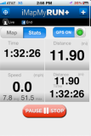
People Connecting to Things
ECG sensor
Internet
Motion sensor
Motion sensor
Motion sensor

Slide 9
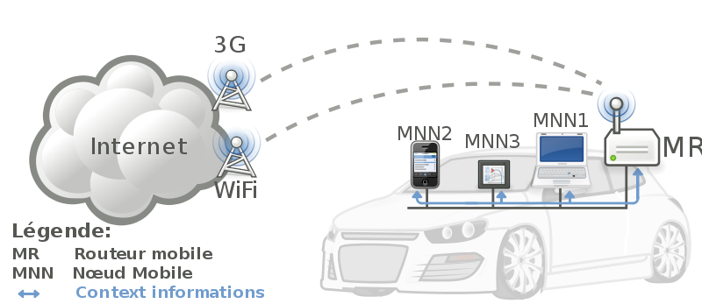


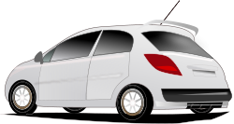
Things Connecting to Things
- Complex and heterogeneous
resources and networks

Slide 10






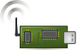
Wireless Sensor Networks (WSN)
End-user
Core network
e.g. Internet
Gateway
Sink
node
Gateway
Computer services
The networks typically run Low Power Devices
Consist of one or more sensors, could be different type of sensors (or actuators)

Slide 11
How are the networks changing?
Extensions
More nodes, more connections, IPv6, 6LowPan,...
Any TIME, Any PLACE + Any THING
M2M, IoT
Billions of interconnected devices,
Everybody connected.
Expansions
Broadband
Enhancements
Smart networks
Data-centric and content-oriented networking
Context-aware (autonomous) systems

Slide 12
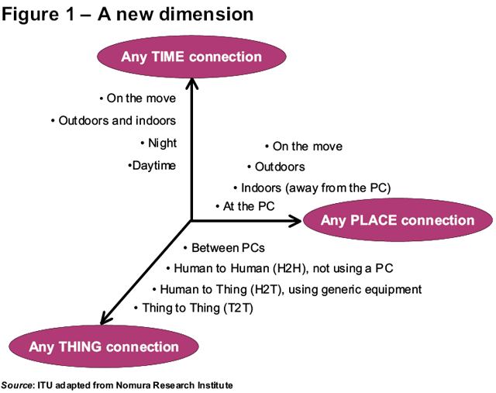
Future Networks

Slide 13
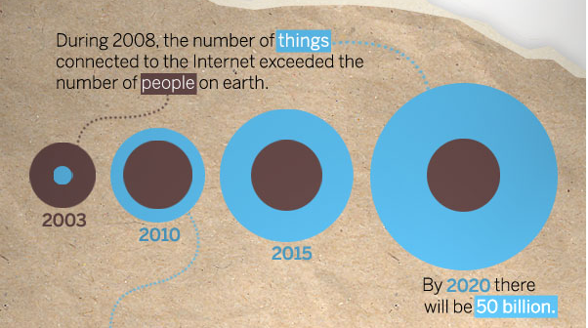
“Thing” connected to the internet
Image Courtesy: : CISCO

Slide 14
IoT
IoTa
IoTi
IoTs
IoTp

Slide 15
Internet of Things (IoT)
Extending the current Internet and providing connection, communication, and inter-networking between devices and physical objects, or "Things," is a growing trend that is often referred to as the Internet of Things.
“The technologies and solutions that enable integration of real world data and services into the current information networking technologies are often described under the umbrella term of the Internet of Things (IoT)”

Slide 16
Why should I learn about IoT?
Business trend
Emerging technologies
Growing IoT Services and Application

Slide 17
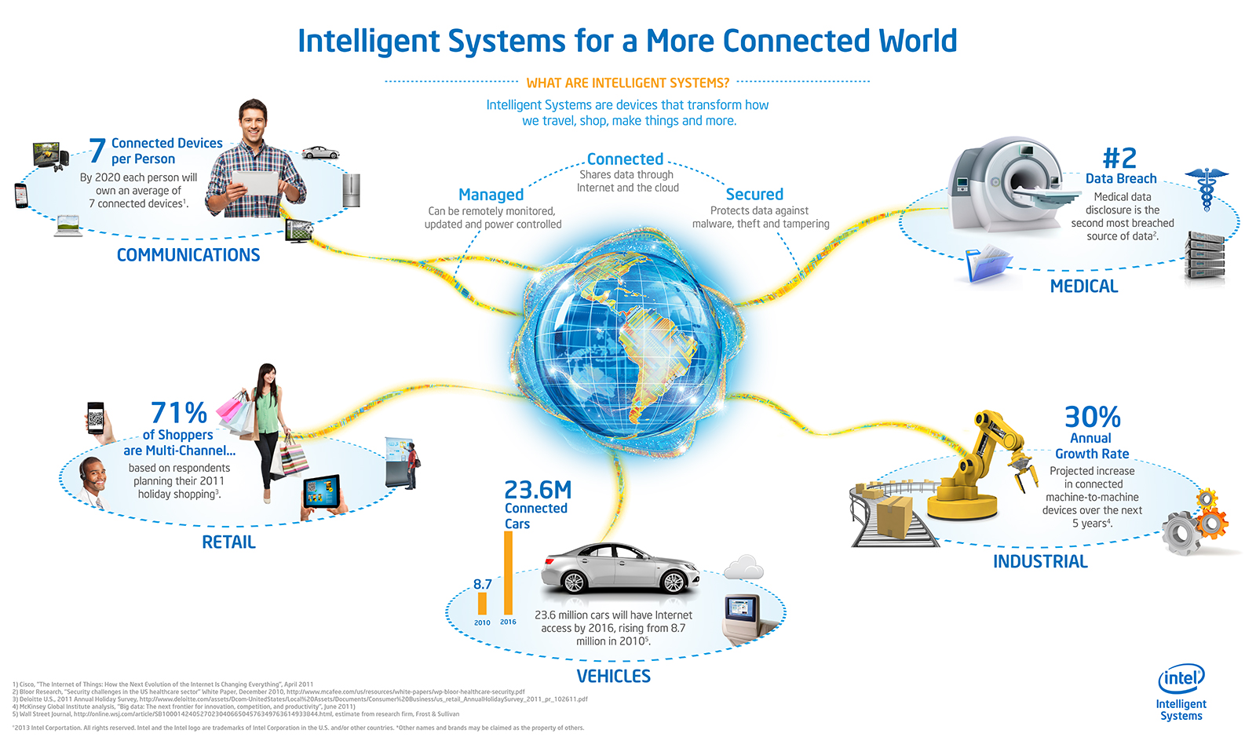
Opportunities
Source: http://blog.trentonsystems.com/internet-of-things-crosses-business-personal-boundaries/

Slide 18
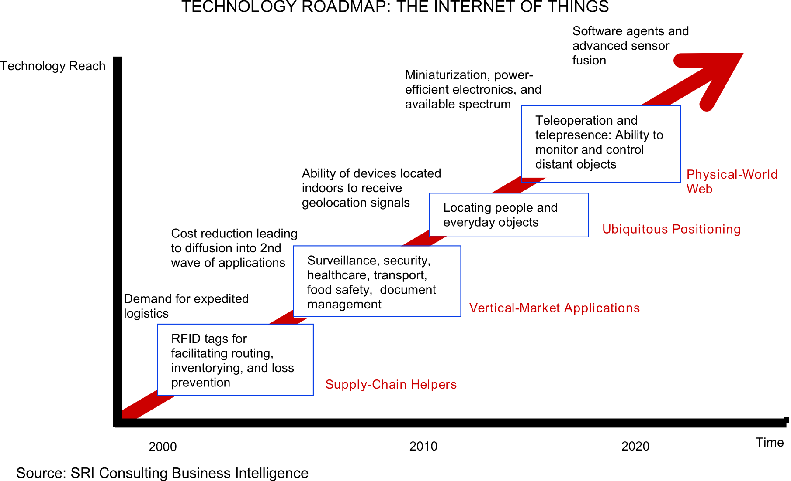
Technology trend

Slide 19
Market growth
“According to a study conducted by Frost & Sullivan in 2011, the global RFID market of $3 billion to $4 billion (in 2009) will grow by twelve percent per year through 2016 and reach a volume of approximately $6.5 billion to almost $9 billion.”
80 percent of all households in the European Union are expected to have intelligent power meters by 2020.
A building’s energy management can then be monitored and administered remotely via a smartphone or a PC. Market experts predict that this global market, which represented $5.3 billion in 2010.
In February 2012 the Chinese government therefore decided to set up a fund of approximately $775 million to support this field in the next five years. It will grow to $11 billion by 2015.
This sector is expected to grow to $116 billion by 2015, according to a report published by the Xinhua News Agency in late 2010.
Source: Siemens, http://www.siemens.com/innovation/apps/pof_microsite/_pof-fall-2012/_html_en/facts-and-forecasts-growth-market-of-the-future.html

Slide 20
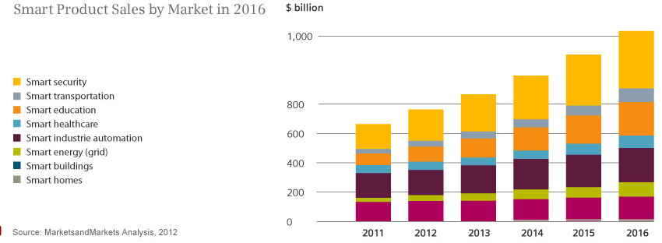
Smart product sales
Source: Siemens, http://www.siemens.com/innovation/apps/pof_microsite/_pof-fall-2012/_html_en/facts-and-forecasts-growth-market-of-the-future.html

Slide 21
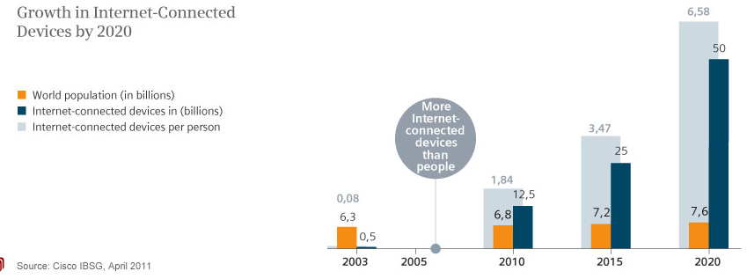
Internet Connected devices
Source: Siemens, http://www.siemens.com/innovation/apps/pof_microsite/_pof-fall-2012/_html_en/facts-and-forecasts-growth-market-of-the-future.html

Slide 22
Global Data Generation
Everyday around 20 quintillion (10^18) bytes of data are produced (Source: http://www-01.ibm.com/software/data/bigdata/).
- This data includes textual content (unstructured, semi-structured, structured) to multimedia content (images, video and audio), on a variety of platforms (enterprise, social media, and sensors).

Slide 23
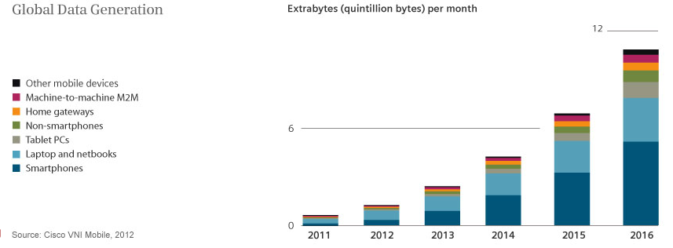
Data Generation

Slide 24
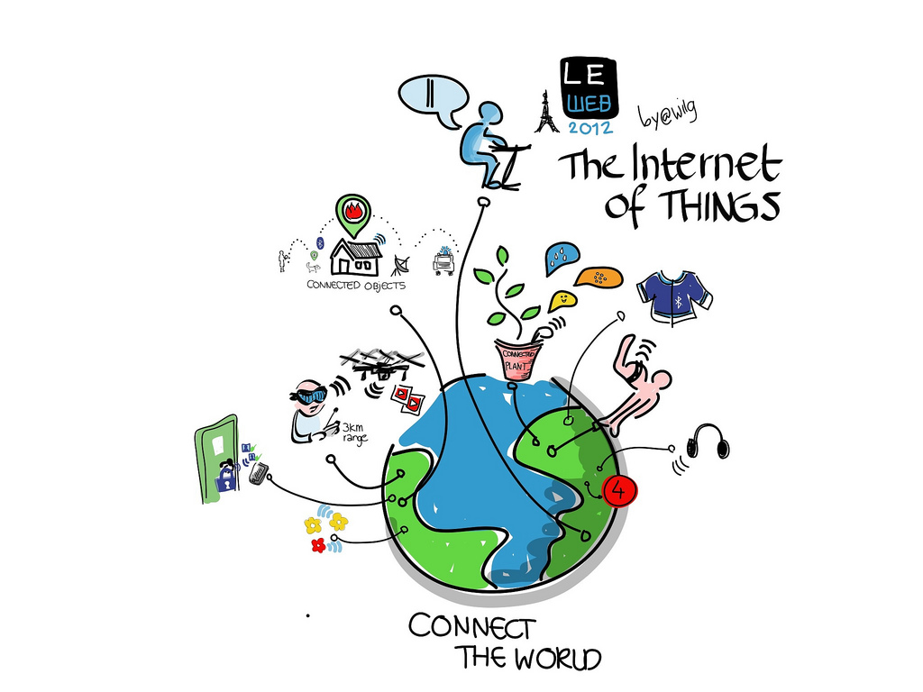
Internet of Things Module
Image courtesy: Wilgengebroed

Slide 25
Topics
Cyber-Physical systems, smart devices, sensors and actuators
Key applications, protocols and architectures
Networks and Communications (Wireless Multi-hop Networks (WMN), Mobile Ad-hoc Networks (MANET), Wireless Sensor Networks (WSN))
Reliability, Security, Privacy and Trust issues and solutions
Software platforms and services
Intelligent Data Processing and Semantic technologies
Connecting things to the Web
Applications, system models, Standards, and Physical-Cyber-Social systems

Slide 26
Module Teaching
Dr Chuan H Foh: Hardware Platforms, Networking and Security
Dr Payam Barnaghi: Services, Data Processing and Applications
3 hours (Lecture + Lab)
Lecture room:
Lab: Penguin Lab (3rd Floor, BB Building)
Thursday, 10am to 13:00pm

Slide 27
Pre-requisites
We expect you are familiar with hardware systems.
We expect you know about basic communication and networking.
We expect you have a knowledge of the object oriented programming.

Slide 28
What is Internet of Things (IoT) - 1
According to Wikipedia, IoT refers to the interconnection of uniquely identifiable embedded computing-like devices within the existing Internet infrastructure. Typically, IoT is expected to offer advanced connectivity of devices, systems, and services that goes beyond machine-to-machine communications (M2M) and covers a variety of protocols, domains, and applications. The interconnection of these embedded devices (including smart objects), is expected to usher in automation in nearly all fields, while also enabling advanced applications like a Smart Grid.

Slide 29
What is Internet of Things (IoT) - 2
Things, in the IoT, can refer to a wide variety of devices such as heart monitoring implants, bio-chip transponders on farm animals, automobiles with built-in sensors, or field operation devices that assist fire-fighters in search and rescue. Current market examples include smart thermostat systems and washer/dryers that utilize WiFi for remote monitoring.

Slide 30
What is Internet of Things (IoT) - 3
Due to the ubiquitous nature of connected objects in the IoT, an unprecedented number of devices are expected to be connected to the Internet. According to Gartner, there will be nearly 26 billion devices on the Internet of Things by 2020. ABI Research estimates that more than 30 billion devices will be wirelessly connected to the IoT by 2020. Per a recent survey and study done by Pew Research Internet Project, a large majority of the technology experts and engaged Internet users who responded. 83% agreed with the notion that the Internet/Cloud of Things and embedded and wearable computing will have widespread and beneficial effects by 2025. It is, as such, clear that the IoT will consist of a very large number of devices being connected to the Internet.

Slide 31
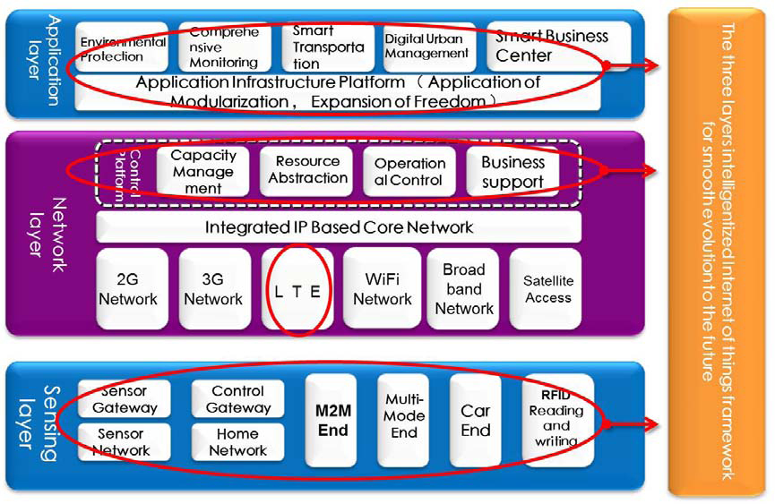
IoT Architecture
Source: Datang Telecom Technology & Industry Group

Slide 32
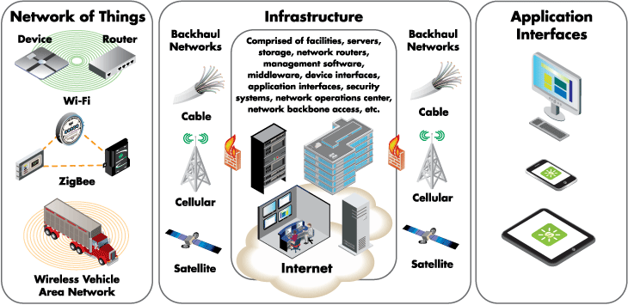
IoT Architecture
Source: digi.com

Slide 33
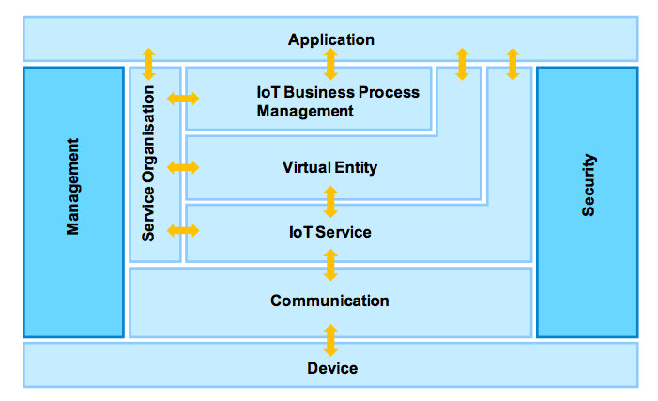
IoT Architecture
Source: IoT-A

Slide 34
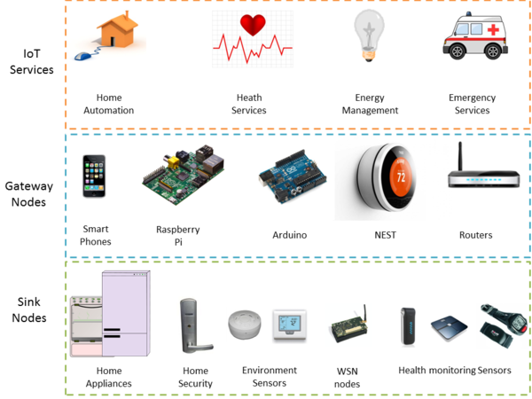
Architecture for Open IoT Services
Source: kno.e.sis

Slide 35
Introductory Videos
Intel IoT -- What Does The Internet of Things Mean?
http://www.youtube.com/watch?v=Q3ur8wzzhBU
Cisco - How the Internet of Things Will Change Everything--Including Ourselves
http://www.youtube.com/watch?v=B_hjAfPJeRA
IBM – Internet of Things
http://www.youtube.com/watch?v=df9xAZZ-8zg
Dr. John Barrett at TEDxCIT – The Internet of Things
http://www.youtube.com/watch?v=QaTIt1C5R-M

Slide 36
What are the major components of IoT?
Sensors/Actuators
Communication between servers or server platforms
Server/Middleware Platforms
Data Analytics Engines
Apps (iOS, Android, Web)

Slide 37
Communication Technologies for IoT
Bluetooth
Zigbee
Z-Wave
NFC (Near-Field Communication)
RFID
WiFi
2G/3G/LTE
Wibro/Mobile WiMax
PLC (Power Line Communication)
Ethernet
What else?

Slide 38
Terminologies similar to IoT
USN (Ubiquitous Sensor Networks)
M2M (Machine-to-Machine)
IoE (Internet of Everything) – Cisco’s favorite term
Cloud of Things
Web of Things

Slide 39
Course Assignments
Will involve a number of things including:
Creating your own homepage/blog/wiki/LinkedIn/Facebook/etc. page
Survey various topics/platforms/tools/devices and presenting your findings in class – class presentations should be prepared in PowerPoint or similar presentation SW
Watching YouTube videos and answering some questions
Developing software for some “things”

Slide 40
Term Project
Will develop an IoT system involving one or more devices, IoT platform, and smartphone app
May be done in groups of 2-3 students
Go through the process of system development life cycle (i.e., project definition, requirements analysis, design, implementation, testing, deployment) and documentation – will be done throughout the course
There will be a final presentation and demo at the end of the term
50% of the course mark will be allocated for this
Think about what you would like to develop!

Slide 41

Q&A

Slide 42
IOT Protocols
Infrastructure (ex: 6LowPAN, IPv4/IPv6, RPL)
Identification (ex: EPC, uCode, IPv6, URIs)
Comms / Transport (ex: Wifi, Bluetooth, LPWAN)
Discovery (ex: Physical Web, mDNS, DNS-SD)
Data Protocols (ex: MQTT, CoAP, AMQP, Websocket, Node)
Device Management (ex: TR-069, OMA-DM)
Semantic (ex: JSON-LD, Web Thing Model)
Multi-layer Frameworks (ex: Alljoyn, IoTivity, Weave, Homekit)

Slide 43
Infrastructure Protocols
6LowPAN
IPv4/IPV6
RPL

Slide 44
Identification
EPC
uCode
IPv6
URIs

Slide 45
Communication
Wifi
Bluetooth
LPWAN

Slide 46
Discovery
Physical Web
mDNS
DNS-SD

Slide 47
Data Protocols
MQTT
CoAP
AMQP
Websocket
Node

Slide 48
Device Management
TR-069
OMA-DM

Slide 49
Semantic
JSON-LD
Web Thing Model

Slide 50
Multi-layer Frameworks
Alljoyn
IoTivity
Weave
Homekit

